Slide 1


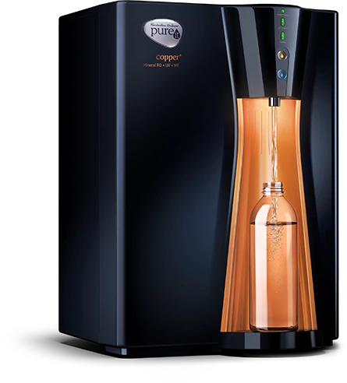
Presented by:
Varun Yashwant Rasalkar 1921452
SUPPLY CHAIN MANAGEMENT
In HUL-PUREIT
SUPPLY CHAIN MANAGEMENT IN PUREIT, HINDUSTAN UNILEVER LIMITED

Slide 2


Hindustan Unilever Limited
Established in: 1933
Website: https://www.hul.co.in
Headquarter: Mumbai, India
Industrial Sector: Consumer Goods
ABOUT
With over 85 years of heritage in India, HUL is India’s largest fast-moving consumer goods company. On any given day, nine out of ten Indian households use our products, giving them a unique opportunity to build a brighter future. They are known for their great brands, the positive social impact they create and their belief in doing business the right way.
MISSION
Our mission is to add Vitality to life. We meet everyday needs for nutrition, hygiene and personal care with brands that help people feel good, look good and get more out of life.
Consumer Use
Consumer Insights
Innovation
Sourcing
Manufacturing
Logistics
Marketing
Sales
Value Creation Model At HUL
VISION
To make sustainable living commonplace. We believe this is the best long-term way for our business to grow.

Slide 3
MARKET ANALYSIS OF HUL
The company has about 21,000 employees and had sales of INR 38,273 crores (the financial year 2019-20).
The company has about 31 company-owned factories and 15 offices spread across India.
HULs product portfolio includes leading household brands such as Lux, Surf Excel, Fair & Lovely, Vaseline, Lakme, Dove, Clinic Plus, Sunsilk, Closeup, Axe, Brooke Bond, Kwality Walls and Pureit and many more.
Pureit is the world’s most advanced range of in-home water purifiers.
It's tagline and claim is that its water is 'as safe as boiled water’.
Website: https://www.pureitwater.com

Slide 4
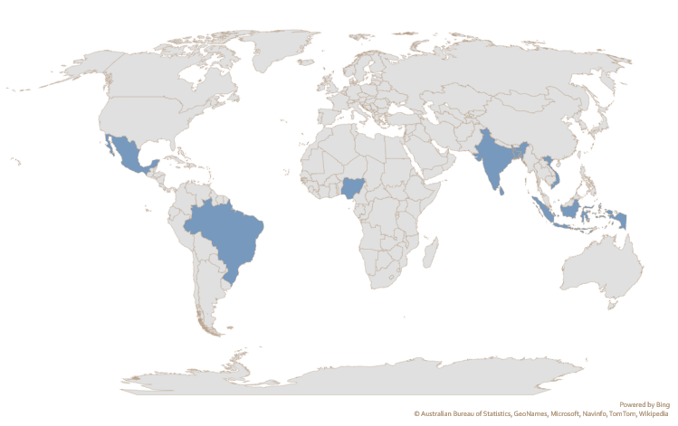
PRODUCT DEVELOPMENT AND MARKET TESTING
Pureit ensures that you get the level of safe drinking water that meets US Environmental Protection Agency norms from the first liter to the last.
It aims to provide complete protection from all water-borne diseases, unmatched convenience and affordability.
A ‘Water Team’ was assigned for the design and development of the product lead by Yuri Jain than VP at HUL in 2000.
It took roughly 200 design changes spanning four years to resolve them all and finally, Pureit launched in 2004, test marketed from 2005-2007, and taken national in 2008.
Now it is sold in 8 countries worldwide.
Current markets where HUL Pureit is sold.

Slide 5
1
Microfibre Filter
Removes visible dirt
2
Activated Carbon Filter
Eliminates harmful parasites & pesticides
3
Germ Kill processor
Kills all harmful bacteria & viruses
4
Clarifier
Removes chlorine & gives clear, odourless & natural testing water
The team had to face many challenges like:
learning how to use new materials,
how to source from new vendors around the world,
and how to develop new manufacturing competencies.
The purifier operates on the principle of gravity and deployed 4 stages of purification initially, now it comes with up to 7 stages of water purification, which includes RO, MF, UV and germ kill kit (GKK) developed by HUL indigenously.

Slide 6
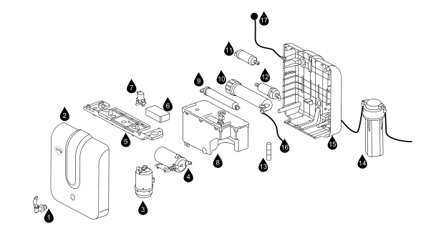
BILL OF MATERIALS (BOM)
01. Tap
02. Front Cover
03. Pre-Carbon Filter
04. Pump
05. Electrical
Assembly
Plate
06. SMPS
07. Solenoid Valve
08. Storage Tank
Assembly
09. Taste
Modulator
10. RO Filter
11. MF Filter / UV Chamber
12. Post-Carbon
Sediment
Filter
13. Flow
Restrictor
14. External SF
Filter
15. Back Cover
16. Reject Water
Pipe
17. Power Cord
SCHEMATICS OF PUREIT ADVANCED RO + MF / RO + UV

Slide 7

PRODUCTION PROCESS OF HUL PUREIT
Production Process
Centralized Production & Assembly
Production of Parts & Assembly
Procurement of Raw Material
Decentralized Production & Assembly
Invitation of Bids
Request for proposal
Direct contracting
Components are produced in company owned factories and third party manufactures
Quality Control
Packaging
Distributor

Slide 8
SUPPLY CHAIN MECHANISM for HUL-PUERIT:
WHOLESALE
Super-stockists
Distributors
RETAIL
Consumer durable stores
(e.g., shops selling kitchen
and household goods or
electronics)
FMCG stores (e.g., pharmacies & supermarkets)
HWTS specialty stores (e.g., HUL’s Safe Water Zones)
Stalls at consumer fairs
Village kiosks
Door-to-door Sales
MANUFACTURER
1.Research and design
2. Manufacturing products
3. Marketing and advertising
WHOLESALE & RETAIL
Distribution hubs and spokes
Rural micro-entrepreneurs
NGO and MFI partners
Government agencies

Slide 9
STAKEHOLDERS and their ROLE in SUPPLY CHAIN SYSTEM of Pureit
STAKEHOLDERS | ROLE IN SUPPLY CHAIN
Academic researchers | Research and development, to innovate
Corporate manufactures | Listen to consumer needs, decide on marketing strategies
Wholesalers | Maintain stocks, link manufactures and retailers
Retailers | Drive product sale, provide consumer feedbacks to manufacturing
Government | Sets tax rates, spread awareness, establish regulatory environment
NGOs & MFIs | Distribute product or Sponsor loans and instalment plans for BPL consumers
Rural microentrepreneurs | Raise awareness of the need for safe drinking water, Distribute product to BPL consumers
Communities | Increase awareness of health, hygiene and sanitation issues
Consumers | Determine product demands, influence product design and market strategies, send feedback on value of product

Slide 10
KEY PERFORMANCE INDICATORS
More than 1,150 supplier's work with the Company’s supply chain spanning own factories and several others that manufacture on the Company’s behalf. The products are stocked in warehouses dotted across the country and delivered to over 4,500 distributors.
Direct-to Home Demonstration system:
HUL built up a 10,000 strong demonstrator team of Pureit Water Experts (PWEs) in partnership with a range of external agencies.
The same demonstrator who educated the consumer also installs the Pureit purifier at the consumer’s home after it had been sold.
About a month later the demonstrator would again visit the home to check on product experience, problems with installation/product, and also get referrals and recommendations for contacting the consumers’ friends and relatives.
Doctor’s Partnership Program:
HUL built brand authority through its ‘Protecting Lives’ Program in which their Pureit Clinic Experts (PCE’s) reached out to 10% of the doctors and other key opinion makers in urban India.

Slide 11
SPECIAL FEATURES OF THE SUPPLY CHAIN
HUL co-operates and engages with Governments, regulators and legislators, both directly and through trade associations, in the development of proposed legislation and regulation which may affect your business interests.
Six HUL factories were recognized at the 2013 Economic Times India Manufacturing Excellence Awards (IMEA).
Unilever’s supply chain team has higher ambitions and is beginning to drive sustainable thinking as an integrated business strategy across multiple tiers in the supply chain, across all five elements of the SCOR framework: DESIGN, SOURCE, MAKE, DELIVER, PLAN, and SELL
HUL is leading towards Green Supply Chain. By 2030, HUL’s goal is to halve the environmental footprint of the making and use of its products as it grows its business.

Slide 12
SWOT ANALYSIS
STRENGHT
Manufacturing, supply chain, suppliers and distributors
HUL is fastest growing FMCG company, it has resources, capital, manufacturing capability and dominance in the market.
WEAKNESS
Consumer Dissatisfaction, confusion in selecting the right product
There are more than 8 variants in Pureit water purifier, which increases confusion among the buyer and if buyer chooses wrong variant, well it creates dissatisfaction.
OPPORTUNITY
Gaining trust in consumer market, increasing quality standardisation
HUL is already a trusted brand in consumer goods. Pureit is pioneer in the market of household water purifier so they have opportunity to increase quality standards in all the domains of production.
THREATS
Competitors, technological innovation
Though HUL is a giant in FMCG, it has competitors like TATA SWACH, KENT, EUREKA FORBES, LG PURICARE and many more have their own technology and innovation.

Slide 13
REFERENCES
Hindustan Unilever Limited website: https://www.hul.co.in
Hindustan Unilever Limited Integrated Annual Report 2019-20
V . Kasturi Rangan, Mona Sinha, (March 28, 2011) “Hindustan Unilever's 'Pureit' Water Purifier”, Harvard Business School.
Adrienne Kols, designed by Dave Simpson and Scott Brown, 2009, “Supply and Demand for Household Water Treatment Products in Andhra Pradesh, Karnataka, and Maharashtra, India”-PATH A Catalyst for Global Health, www.path.org

